Slide 1
PowerBI
Introduction
Sreenivas V

Slide 2
What is PowerBI
PowerBI is a suite of business analytics tools that deliver insights throughout your organization
Connect to hundreds of data sources, simplify data prep, and drive ad hoc analysis
Produce beautiful reports, then publish them for your organization to consume on the web and across mobile devices
Everyone can create personalize dashboards with a unique, 360-degree view of their business. And scale across the enterprise, with governance and security built-in

Slide 3
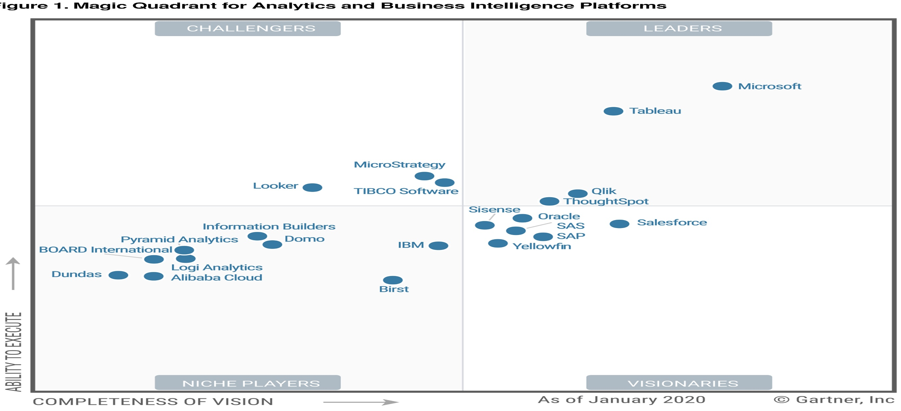
Gartner’s Magic Quadrant for BI – Jan-2020

Slide 4
Power BI Architecture
A business suite that includes several technologies that work together
Power BI technology consists of a group of components such as:
Power Query (for data mash-up and transformation)
Power BI Desktop (a companion development tool)
Power BI Mobile (for Android, iOS, Windows phones)
Power Pivot (for in-memory tabular data modeling)
Power View (for viewing data visualizations)
Power Map (for visualizing 3D geo-spatial data)
Power Q&A (for natural language Q&A)

Slide 5
Power BI Architecture
Power BI takes data from various data sources such as files, Azure source, online services, DirectQuery or gateway sources
Using Power BI Desktop one can work with data by importing and cleaning and transforming according to the needs
Once the data is transformed and formatted, it is ready to use in making visualizations in a report
A report is a collection of visualizations like graphs, charts, tables, filters, and slicers
One can publish the reports created in Power BI desktop on two kinds of platforms; Power BI Service and Power BI Report Server
Power BI Service is a cloud-based public platform whereas Report Server is an on-premise platform protected by firewall security
Create dashboards on these platforms by pinning visualizations from your published reports
Share dashboards and reports and collaborate with others from organization or outside, using delivery options like a web-browser, Power BI on iPad, tablets, laptops, phones, etc.

Slide 6
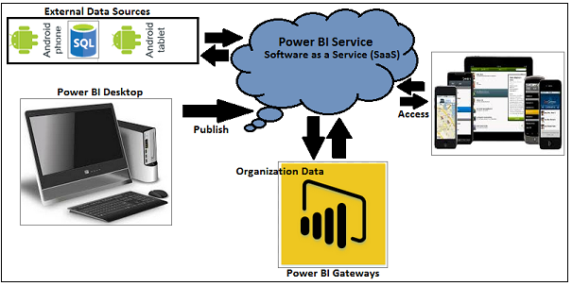
Architecture

Slide 7
Architecture – Product Components
Data Sources - Import data from files in your system, cloud-based online data sources or connect directly to live connections. When importing from data on-premise or online services there is a limit of 1 GB
Power BI Desktop − This is used to create reports and data visualizations on the dataset - is known as client-side tool - companion development and authoring tool
Power BI Service – a web-based platform from where one can share reports made on Power BI Desktop, collaborate with other users, and create dashboards. It is available in three versions – Free version, Pro version, Premium version
Power BI Report Server – Enables you to create dashboards and share your reports with other users following proper security protocols. To use this service, you need to have a Power BI Premium license.
Power BI Service − This is a cloud service and is used to publish Power BI reports and data visualizations

Slide 8
Architecture – Product Components
Power BI Gateway − You can use Power BI on-premises gateway to keep your data fresh by connecting to your on-premises data sources without the need to move the data. It allows you to query large datasets and benefit from the existing investments
Power BI Mobile Apps − Using Power BI mobile apps, you can stay connected to their data from anywhere. Power BI apps are available for Windows, iOS, and Android platform
Power BI Embedded – Offers APIs which are used to embed visuals into custom applications

Slide 9
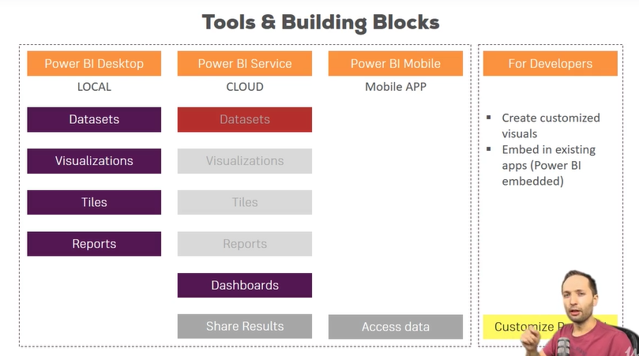
Tools & Building Blocks

Slide 10
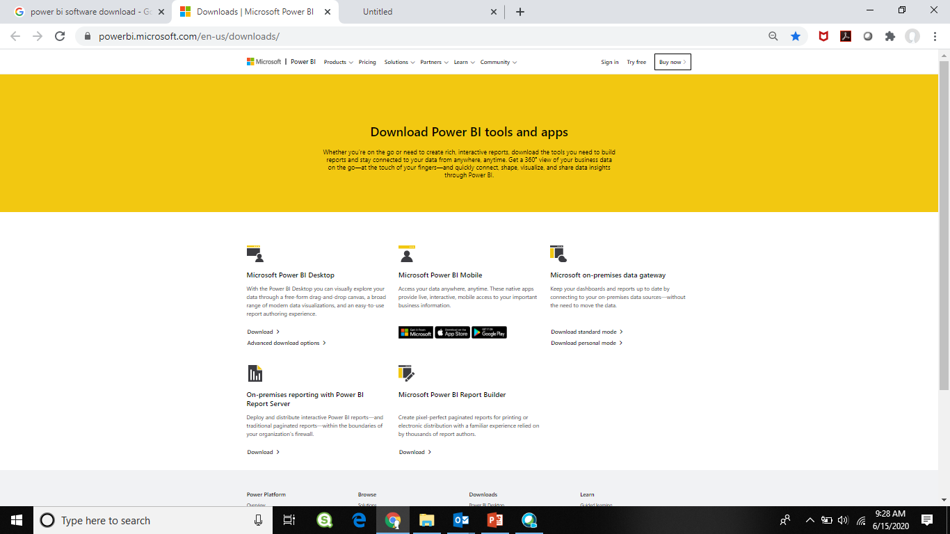
SW to download
https://powerbi.microsoft.com/en-us/downloads/

Slide 11
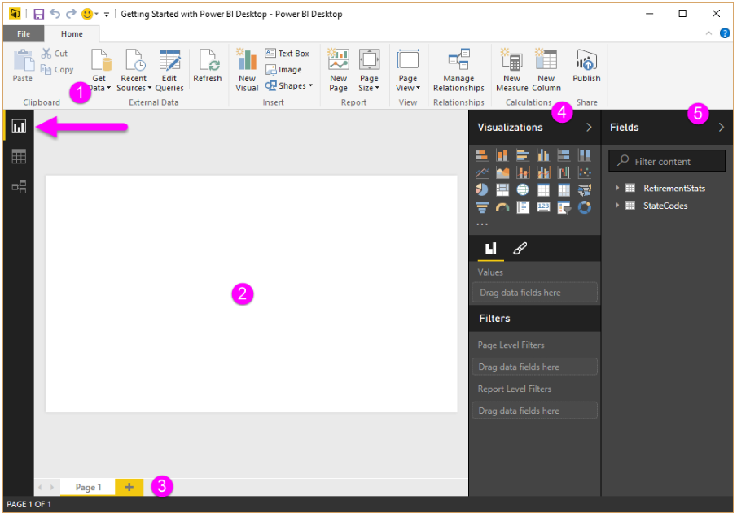
Power BI Desktop Report view
Five main areas:
The Ribbon, which displays common tasks associated with reports and visualizations
The Report view, or canvas, where visualizations are created and arranged
The Pages tab area along the bottom, which lets you select or add a report page
The Visualizations pane, where you can change visualizations, customize colors or axes, apply filters, drag fields, and more
The Fields pane, where query elements and filters can be dragged onto the Report view, or dragged to the Filters area of the Visualizations pane

Slide 12
Power BI Desktop Report view

Slide 13
Task – 1
Get some
On-Line data : IMF WORLD ECONOMIC OUTLOOK DATABASE 2017 April –
Gross domestic product, current prices in US dollars
clean it, : - Remove Top Rows
- Use First Row as Header
- Remove unwanted Columns
- Transform Columns to Rows (UnPivot)
- Rename Columns
- Remove n/a Rows
- Change Data Formats (Types)
- Change Data type of Country
model it and : Let us skip for now
Build Visual - Build Visual

Slide 14
Data Loading

Slide 15
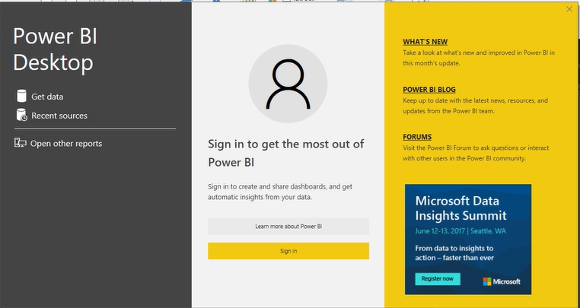
First Page – Getting Started

Slide 16
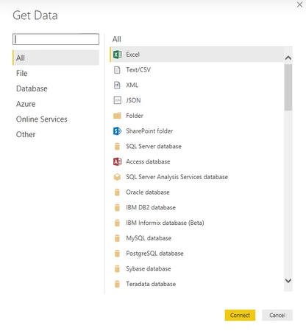
Get Data

Slide 17
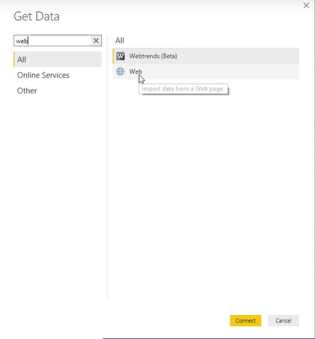

Get Data from Web
IMF WORLD ECONOMIC OUTLOOK DATABASE 2017 April

Slide 18
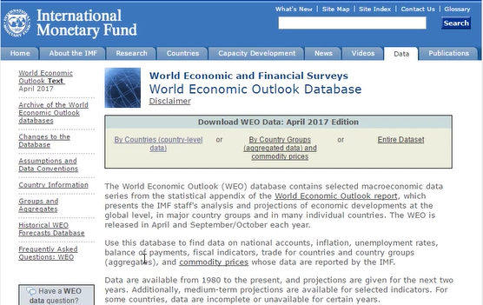
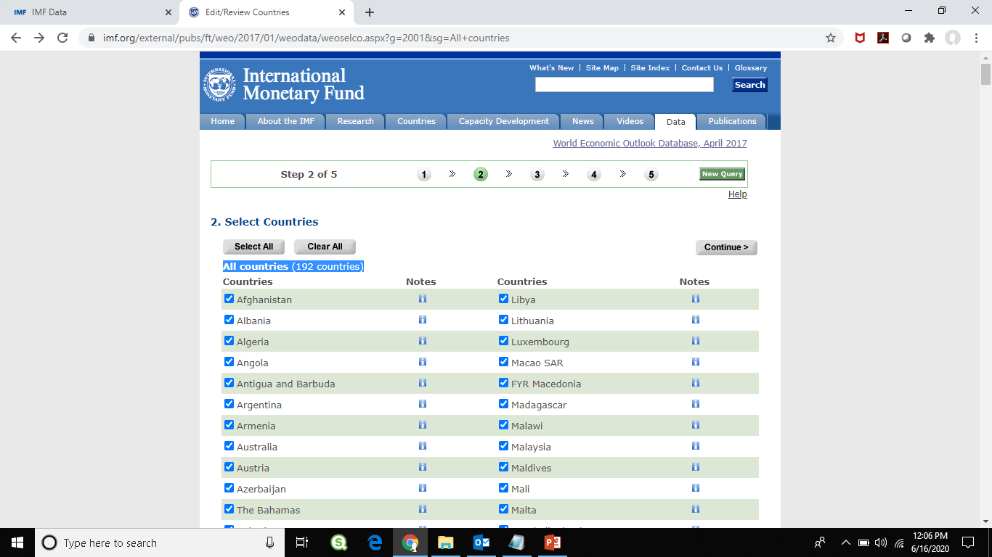
Select required table – Gross domestic product, current prices in US dollars
Click – By Countries (Country level data)
Click – All countries

Slide 19
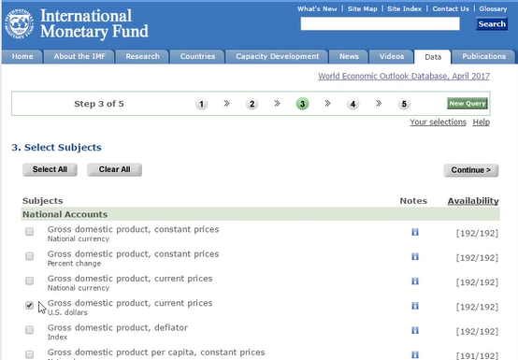
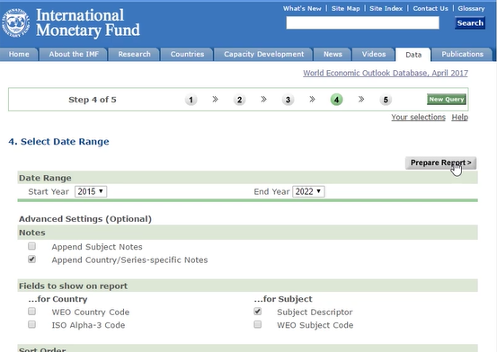
Select Subject → Select the fields →
Select Gross Domestic Product Current Prices US Dollars
Click – Continue
Click – Prepare Report

Slide 20
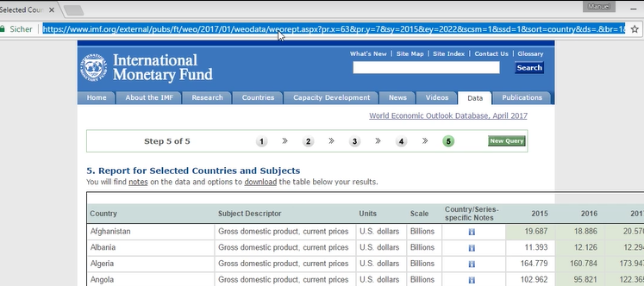
Now copy the URL

Slide 21
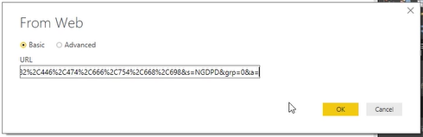
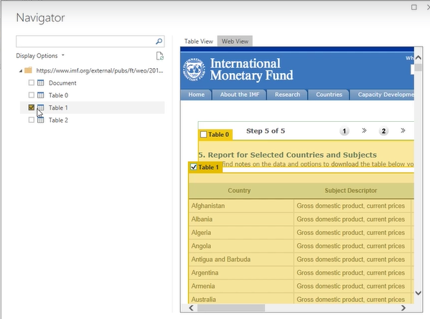
Paste in our PowerBI – Web URL location – Select Table-1

Slide 22
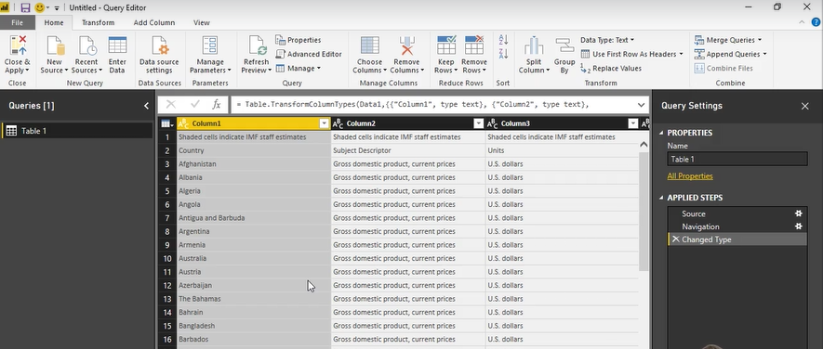
Load to Query Editor

Slide 23
Data Cleansing

Slide 24
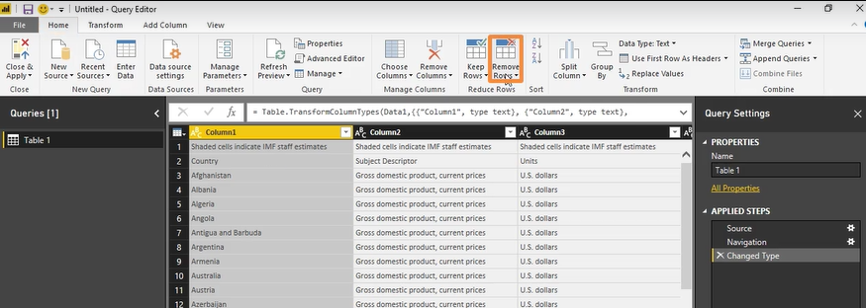
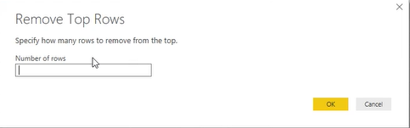
Remove Top Rows

Slide 25
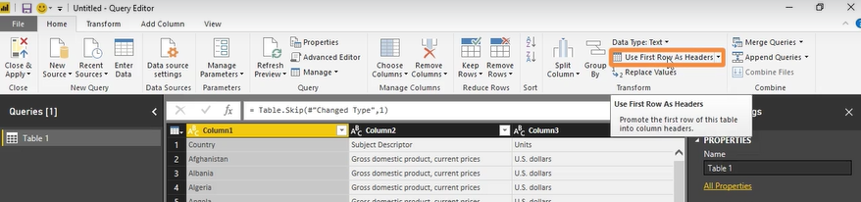
Use first row as header

Slide 26
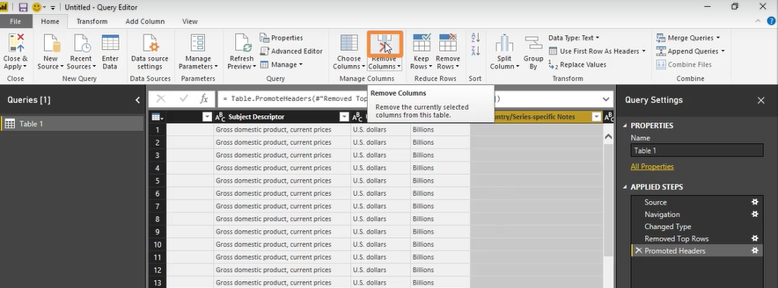
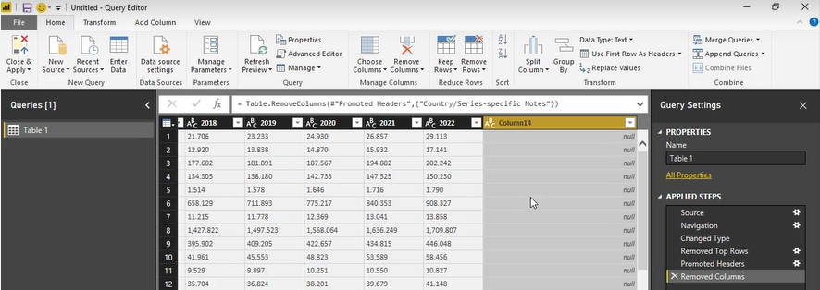
Remove Columns

Slide 27
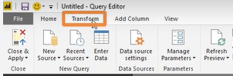
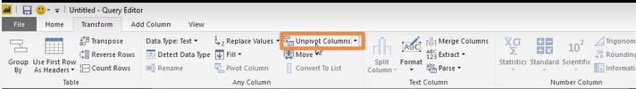
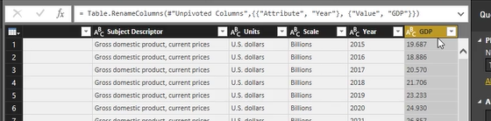
Transform – Unpivot columns – Rename columns

Slide 28
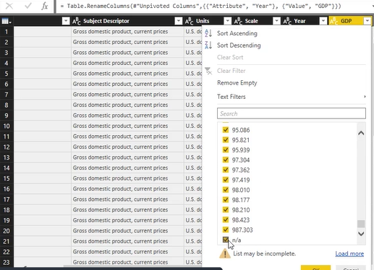
Remove n/a values by clicking column header

Slide 29
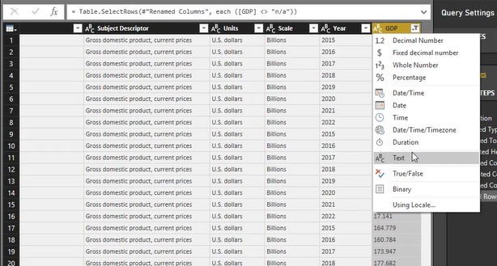
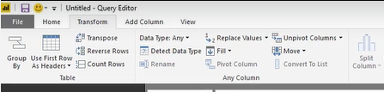
Changing Data Formats (Types)

Slide 30
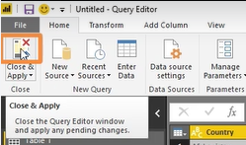
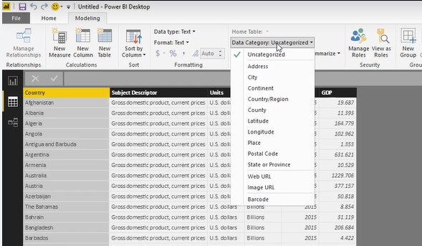
Close the Query Editor and go to Data View – Change data type of Country

Slide 31
Data Visualizing

Slide 32
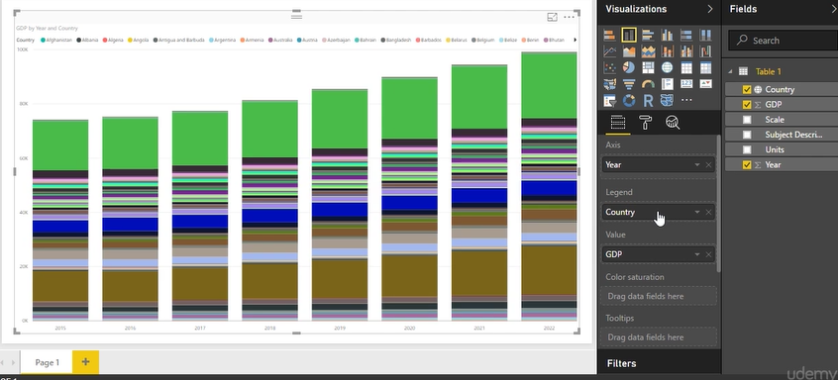
Go to Report View
Drag Year → Axis
GDP → Value
Country → Legend

Slide 33
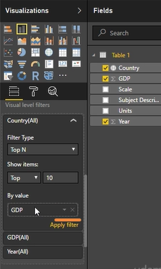
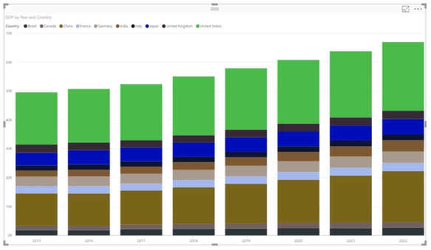
Apply filter – Top 10 countries by GDP

Slide 34
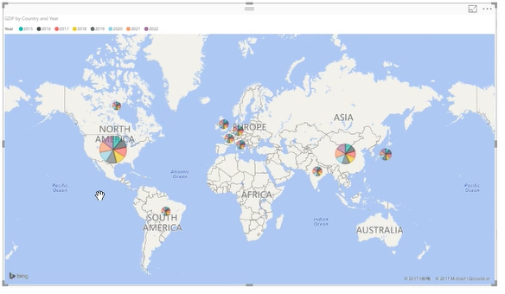
Applying the Map View – Yearly GDP by country

Slide 35
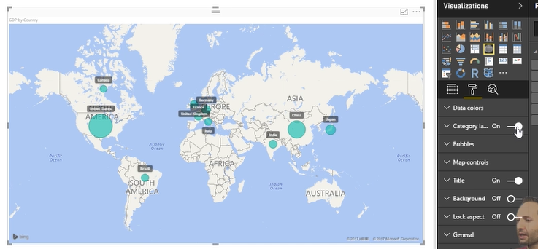
Applying Country Labels

Slide 36
Thank you

Slide 37
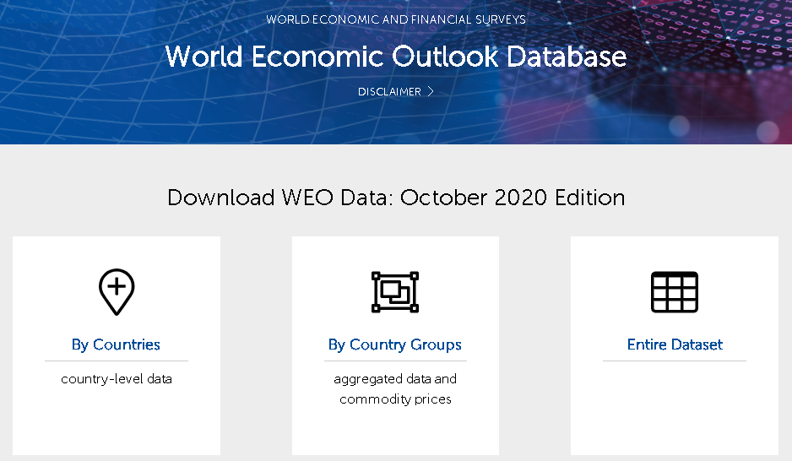

Slide 38
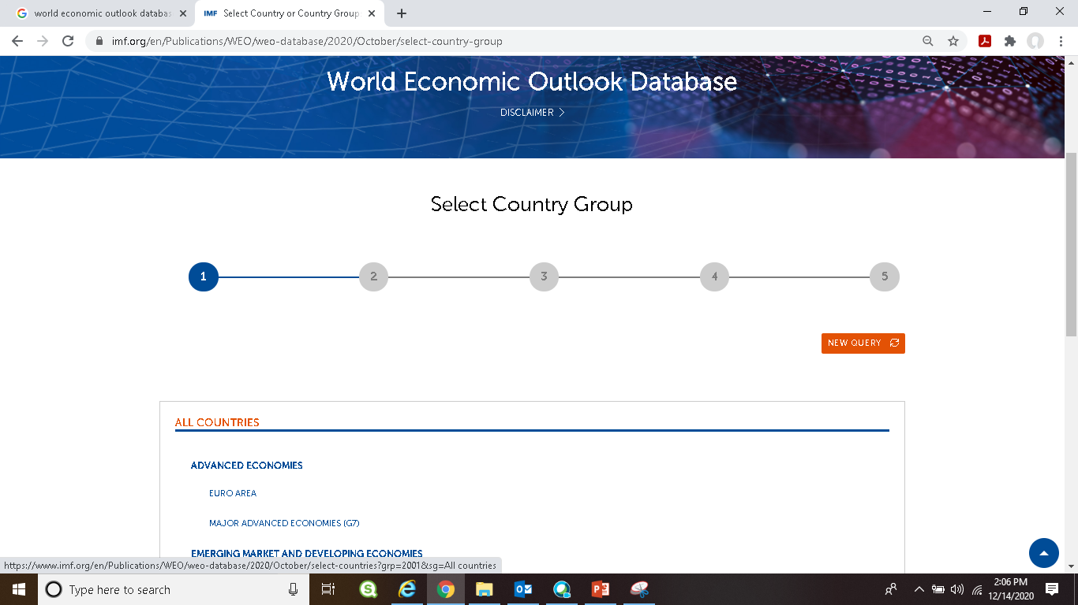

Slide 39
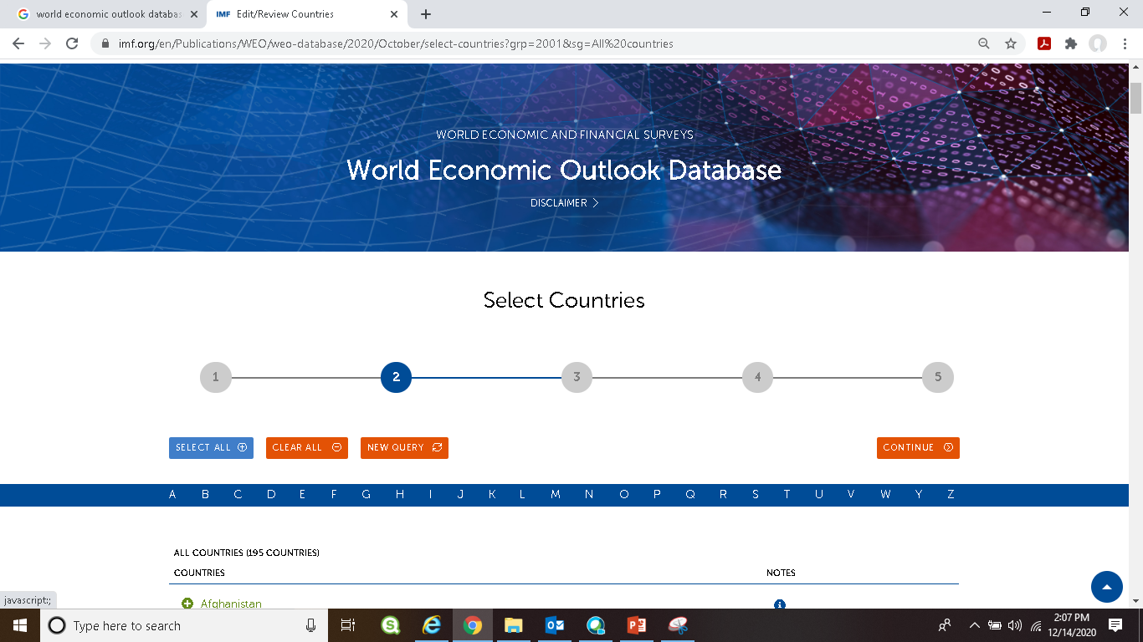

Slide 41
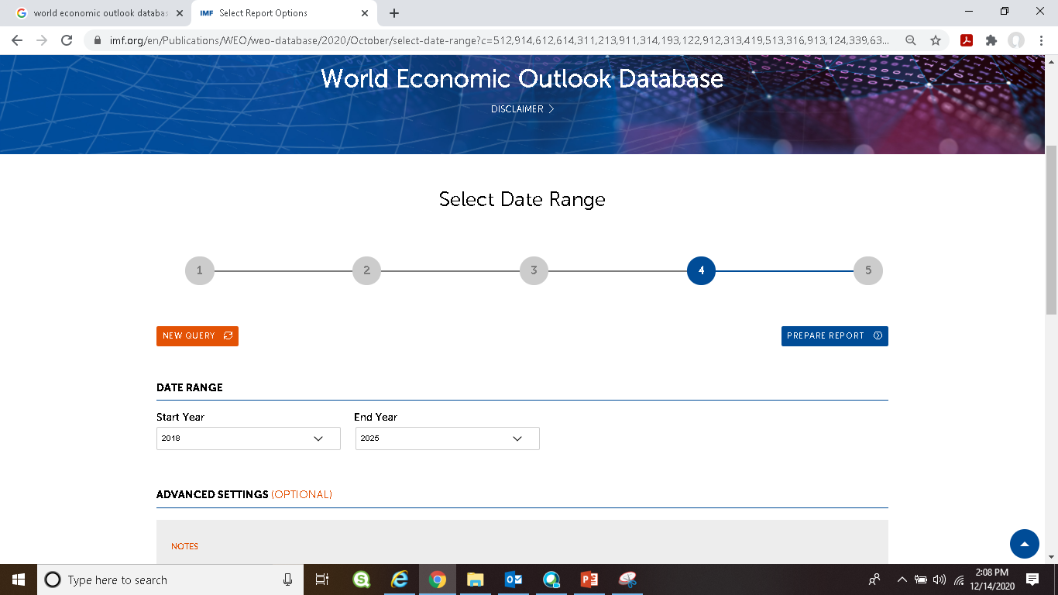

Slide 42
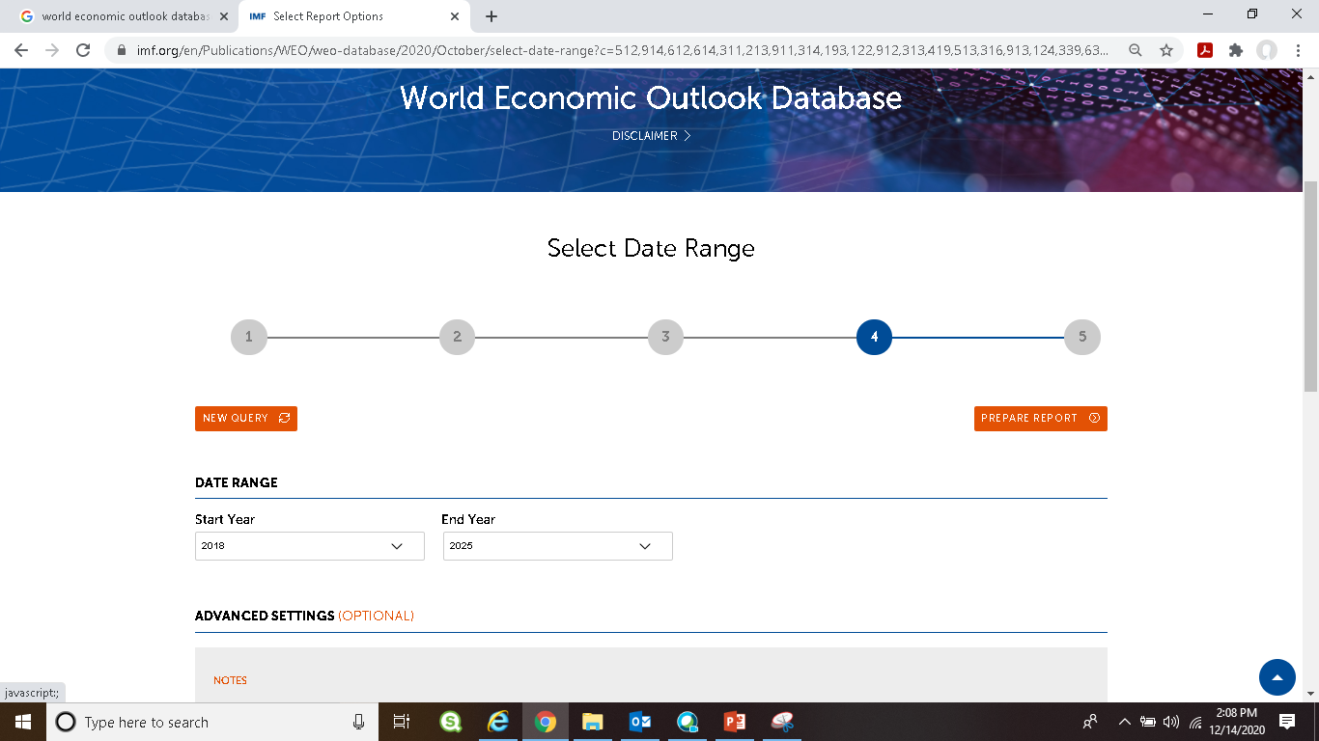

Slide 43
